Slide 1
Sun Metro Title VI Training
Last Updated January 23, 2025

Slide 2
What is Title VI?
Title VI of the Civil Rights Act of 1964 protects people from discrimination based on race, color or national origin in programs or activities that receive Federal financial assistance.
In addition to Title VI, Sun Metro also prohibits discrimination based on sex, age, disability, religion or any other protected classes as described in State or Federal laws. For the purpose of this training, Title VI is the main focus.

Slide 3
Why is Title VI Important?
Ensures that public services, including transportation, are provided in a nondiscriminatory manner.
Requires opportunities for public participation in decision-making without regard to race, color, or national origin, including populations with Limited English Proficiency (LEP).
Title VI non-compliance can cause federal funding to be conditioned or withheld.

Slide 4
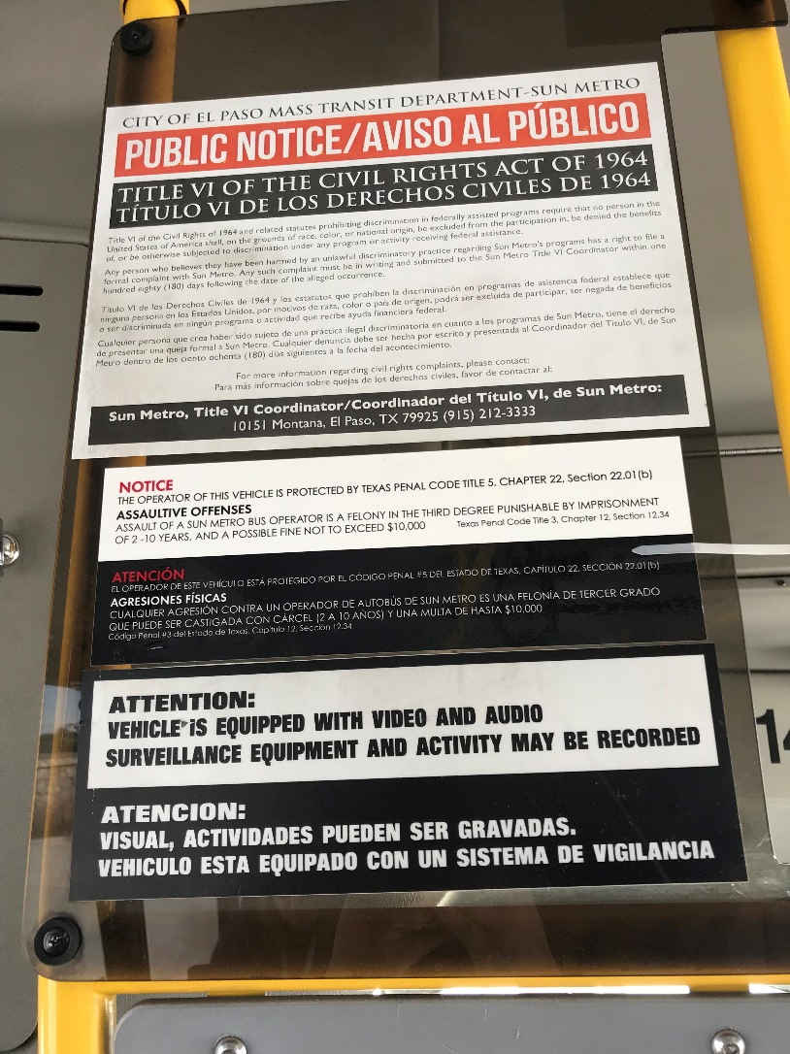
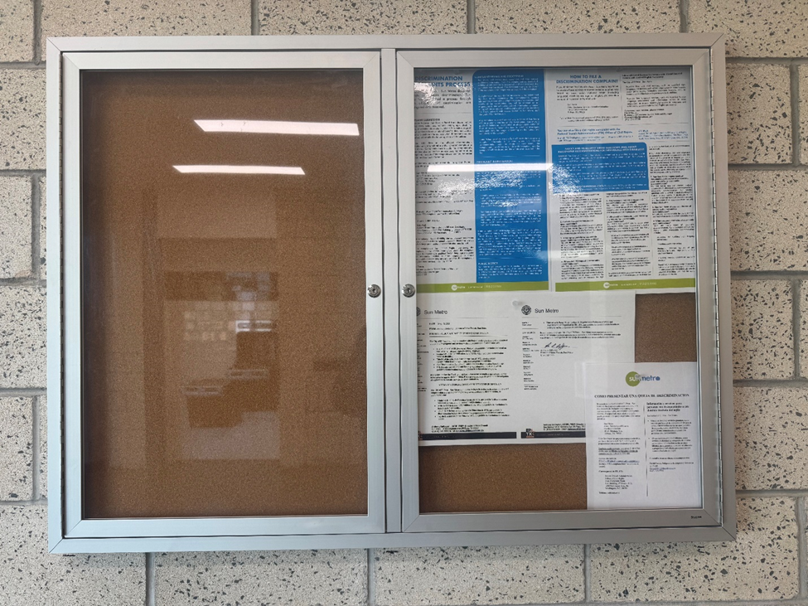
Notice to Beneficiaries
Sun Metro is committed to ensuring that the public is aware of the rights and protections afforded to them under Title VI.
Notice regarding Sun Metro’s Civil Rights Policy has been disseminated throughout the bus and streetcar systems in both English and Spanish.
The materials include posters displayed at transit terminals, printed and digital notifications on revenue vehicles, as well as on Sun Metro’s website.

Slide 5
Complaint Form
Sun Metro has established a process for system users to file a complaint under Title VI. Any person who believes they have been discriminated against on the basis of race, color, or national origin may fill out a complaint form. Forms are available on Sun Metro’s website.

Slide 6
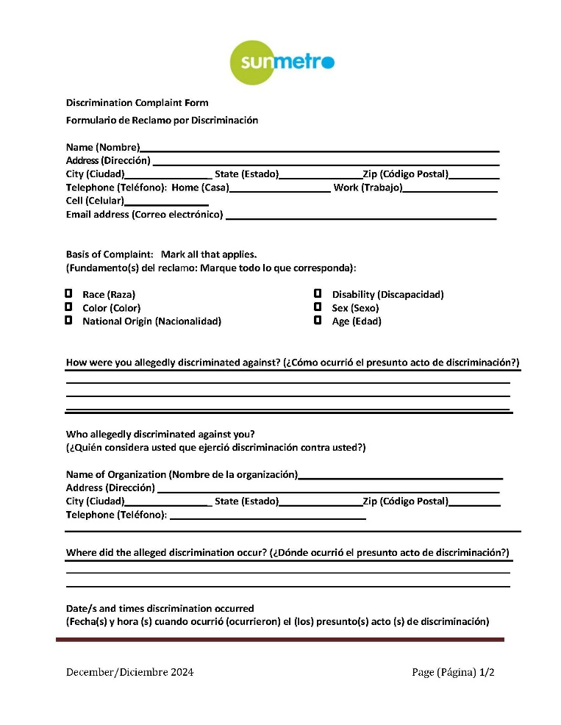
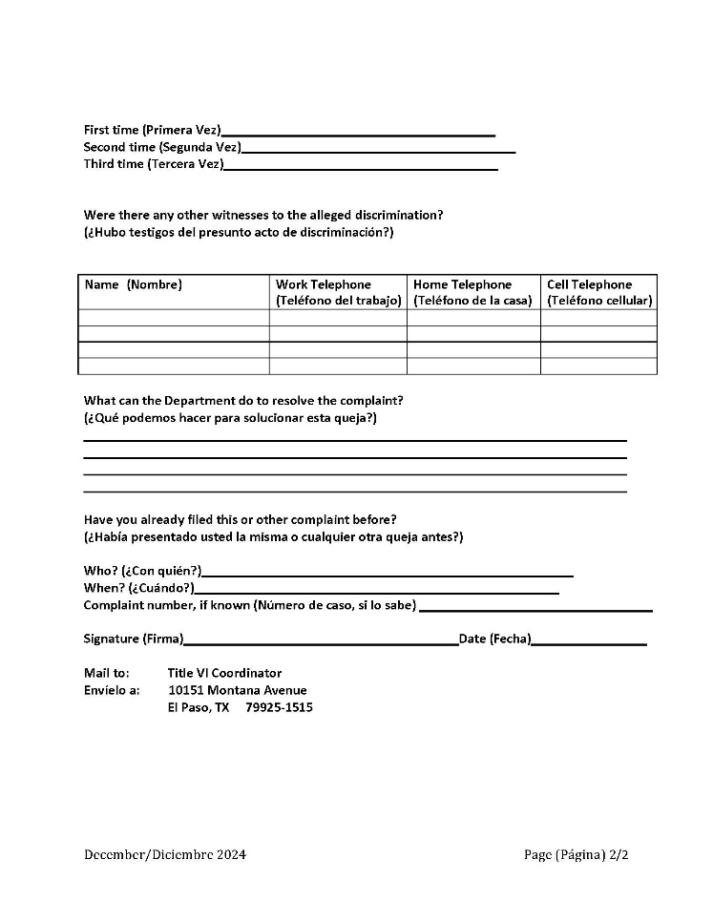
Complaint Form (cont’d)

Slide 7
Active Lawsuits, Complaints or Inquiries Alleging Discrimination
Currently, there are no complaints pending that allege discrimination on the grounds of race, color, national origin or any other form of discrimination.

Slide 8
Sun Metro’s Public Participation Plan
Sun Metro uses the El Paso Metropolitan Planning Organization’s Public Participation Program, which was revised September 20, 2024 and is available at: https://www.elpasompo.org/media/PublicParticipationPlan/PublicParticipationPlan.pdf
The plan incorporates the following outreach efforts which help alert riders and encourage engagement:
Newspapers and other periodicals
Bus and bus shelter advertisements
Website
Social Media
Public Hearings/Public Information Sessions

Slide 9
Public Comments
All comments received through the public participation plan are given careful, thoughtful consideration. Due to a number of different ways system users or community members can comment on proposed service or fare changes (mail, email, social media, public meetings and others), all comments are assembled into a single document for presentation to the Mass Transit Department Board for consideration.

Slide 10
Construction Equity Analysis
Sun Metro prepares advanced planning reports prior to the construction of transit-related facilities. This includes:
Transit Terminal Demand Analysis: review of service improvements.
Transit Terminal Site Selection Analysis: research and collection of demographic data.
Environmental Assessment: determine any environmental consequences and investigates solutions to mitigate any negative impacts.

Slide 11
Title VI Equity Analysis Policies and Procedures
The Federal Transit Administration (FTA) requires Sun Metro to adopt Title VI Equity Analysis Policies. These include:
Major Service Change Policy;
Disparate Impact Policy; and
Disproportionate Burden Policy.
The purpose of service and fare equity analyses prior to implementing service and/or fare changes is to determine whether the planned changes will have a disparate impact on the basis of race, color, national origin or income.

Slide 12
Title VI Equity Analysis Policies and Procedures (cont’d)
FTA Circular 4702.1B requires transit agencies that serve urbanized areas of 200,000 people or greater to evaluate significant system-wide service and fare changes at the planning and programming stages to determine whether proposed changes would have a discriminatory impact.
For service changes, this requirement applies to “major service changes” only, and the recipient establishes guidelines or thresholds for what it considers a “major service change.”

Slide 13
Major Service Change Policy
All major increases or decreases in transit service are subject to a Title VI Equity Analysis and must be presented to the Sun Metro Mass Transit Department Board (MTDB).
Sun Metro has defined a major service change as a reduction or increase of 30 percent or more in total vehicle revenue miles or total revenue hours in service in any service area during a service review period.

Slide 14
Disparate Impact Policy
According to the FTA, Disparate Impact refers to a facially neutral policy or practice that disproportionately affects members of a group identified by race, color, or national origin, where the recipient’s policy or practice lacks a substantial legitimate justification and where there exist one or more alternatives that would serve the same legitimate objectives but with less disproportionate effect on the basis of race, color, or national origin.
Sun Metro’s policy establishes a 25 percent threshold for determining whether a given action has a disparate impact on minority populations.

Slide 15
Disproportionate Burden Policy
According to the FTA, Disproportionate Burden refers to a neutral policy or practice that disproportionately affects low-income populations more than non-low-income populations. A finding of disproportionate burden requires the recipient to evaluate alternatives and mitigate burdens where practicable.
Sun Metro’s policy establishes a 25 percent threshold for determining whether a given action has a disproportionate burden on low-income populations versus non-low-income populations.

Slide 16
Service and Fare Change Process
The following chart depicts the overall process to conduct a fare or service change.

Slide 17
Limited English Proficiency (LEP)

Slide 18
What Does LEP Mean?
English is not the primary language.
Limited ability to read, speak, write, or understand English.
LEP individuals are among the most transit-dependent, but they are also choice riders.
Outreach to dependent communities is a way to increase ridership without adding service or increasing fares.

Slide 19
Executive Order 13166
“Improving Access to Services for Persons with Limited English Proficiency” requires each federal agency to:
Examine the services it provides;
Develop and implement a system by which LEP persons can meaningfully access those services;
Ensure that recipients of federal financial assistance provide meaningful access to their LEP beneficiaries.

Slide 20
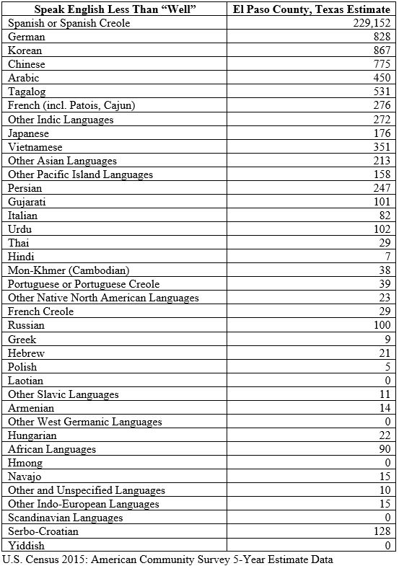
El Paso County Population
Total Population: 865,657
Total Population of LEP Individuals: 27%

Slide 21
The LEP Community
While the need to provide language services to the Spanish-speaking population in the Sun Metro service area is crucial, it is also helpful to understand where populations of limited English proficiency reside.
The following map provides a spatial display of residents who report speaking English “less than well.”

Slide 22
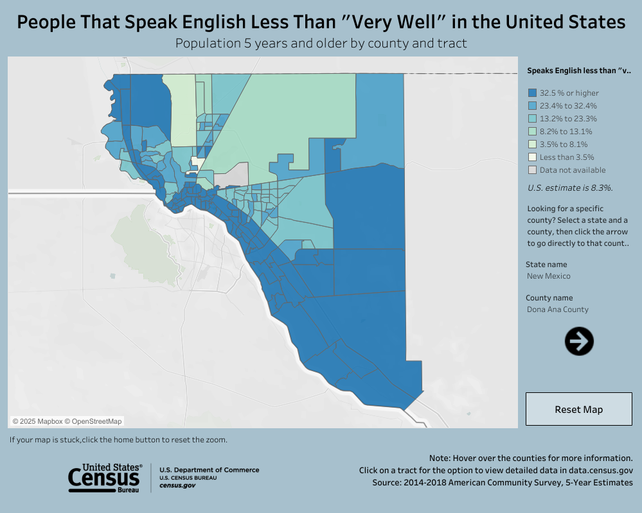
The LEP Community

Slide 23
Language Assistance
If the person can speak some English, try to discern their needs without the help of language service;
If the employee cannot effectively communicate with the person, refer the individual to the Title VI Notice, where they can obtain Sun Metro’s Customer Service number for further assistance.

Slide 24
Contact
For additional information on Sun Metro’s Title VI Plan or its efforts to comply with the Civil Rights Act of 1964 or Executive Order 13166: Improving Access to Service for Persons with Limited English Proficiency, please contact:
Jerry DeMuro
Title VI Liaison
Sun Metro
10151 Montana Ave
El Paso, Texas 79925
(915) 212-3470
DeMuroG@elpasotexas.gov

Slide 25
Questions?

Slide 26
Quiz: Question #1
What does Title VI protect?
Race
Color
National Origin
All of the Above

Slide 27

Quiz: Question #1
What does Title VI protect?
Race
Color
National Origin
All of the Above

Slide 28
Quiz: Question #2
Where can an individual access the Title VI Complaint Form?
On the bus
City Hall
Sun Metro’s website
Local police station

Slide 29
Quiz: Question #2
Where can an individual access the Title VI Complaint Form?
On the bus
City Hall
Sun Metro’s website
Local police station

Slide 30
Quiz: Question #3
If an individual speaks English “less than well,” they are considered to be LEP. What does this acronym stand for?
Limited Educational Possibilities
Limited English Proficiency
Limited Excellence in Professionalism
Limited English Person

Slide 31
Quiz: Question #3
If an individual speaks English “less than well,” they are considered to be LEP. What does this acronym stand for?
Limited Educational Possibilities
Limited English Proficiency
Limited Excellence in Professionalism
Limited English Person

Slide 32
Quiz: Question #4
What qualifies as a Major Service Change?
30% reduction in bus service
10% increase in bus service
5% reduction in bus service
All of the above

Slide 33
Quiz: Question #4
What qualifies as a Major Service Change?
30% reduction in bus service
10% increase in bus service
5% reduction in bus service
All of the above

